Slide 1

Parallel & Distributed Computing
By: Shiwani Dembla
Instructor: Noor Nabi Dahar

Slide 2
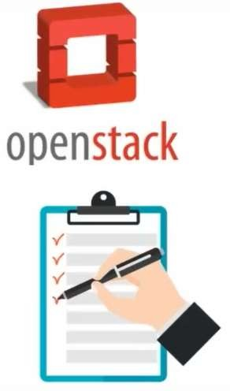
OpenStack Topics
What is OpenStack
Deployment Models
OpenStack Architecture
OpenStack Components

Slide 3
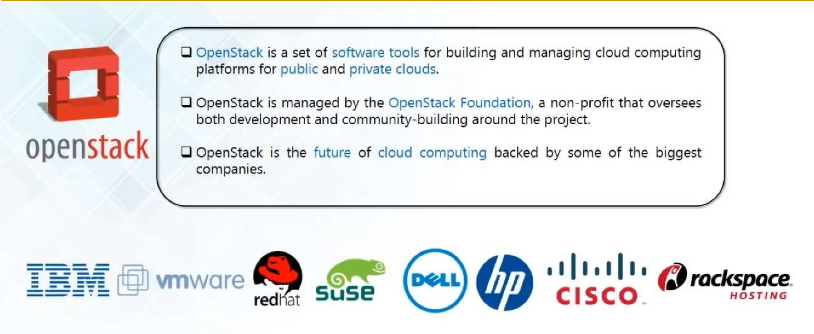
What is OpenStack?

Slide 4
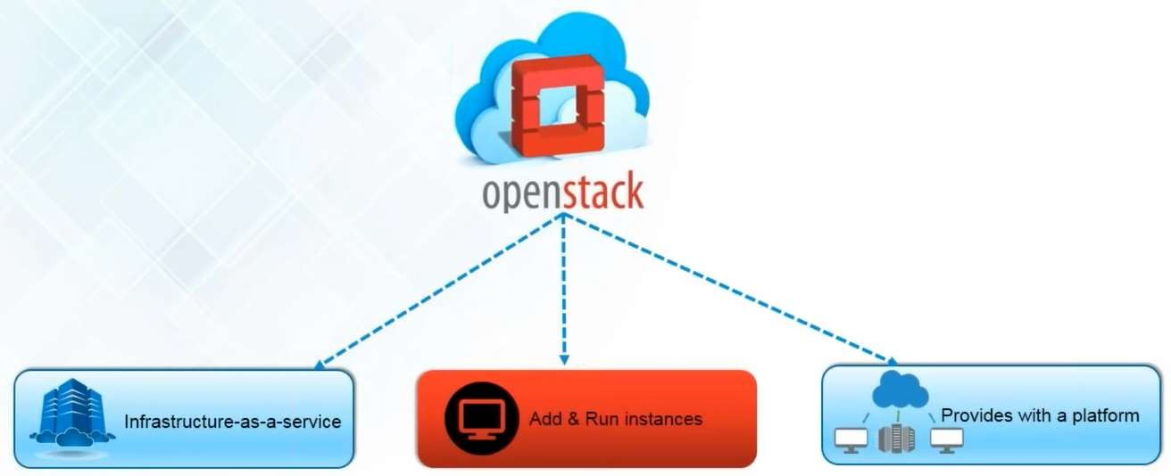
What is OpenStack?

Slide 5
OpenStack as IaaS
Manages, Configures and Provides following resources:
Compute (Computation)
Networking
Storage
Sometimes can be used as an alternative to AWS or Azure.

Slide 6
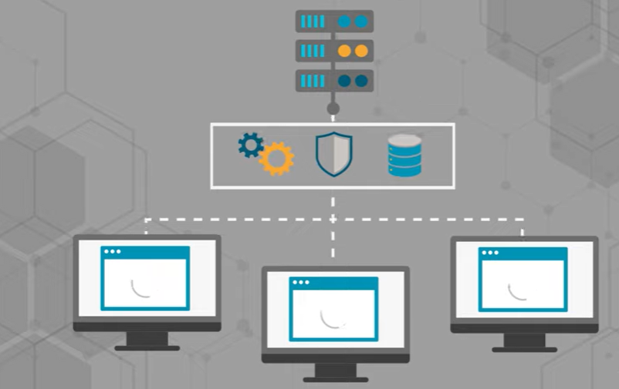
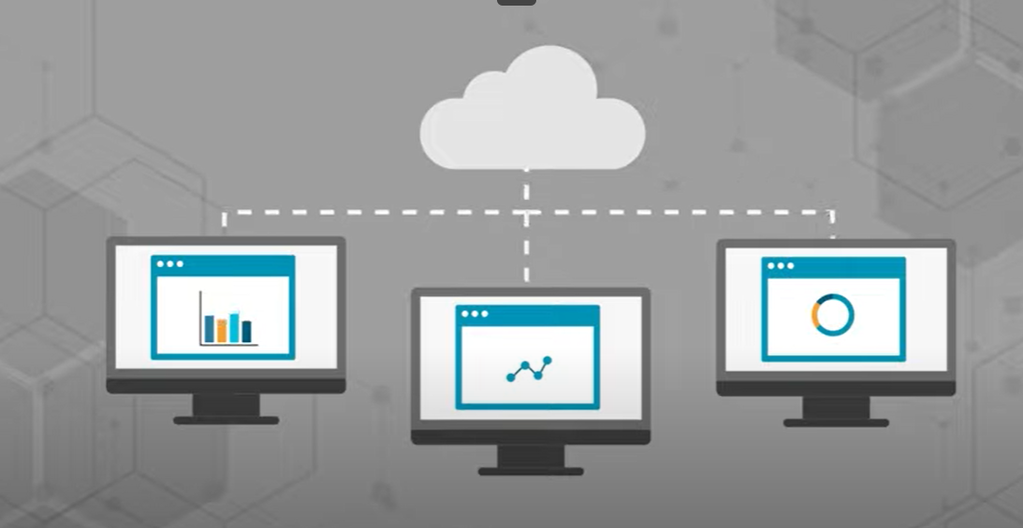
Why OpenStack?
Openstack is installed in virtualized layer, which forms a cloud operating system which fasten the resources pooling.

Slide 7
Why OpenStack?
Affordable.
Reliable.
Open source.
Ready Made.
Strong Community.
Self-Service Automation (Users & Administrators interact Directly with automations).

Slide 8
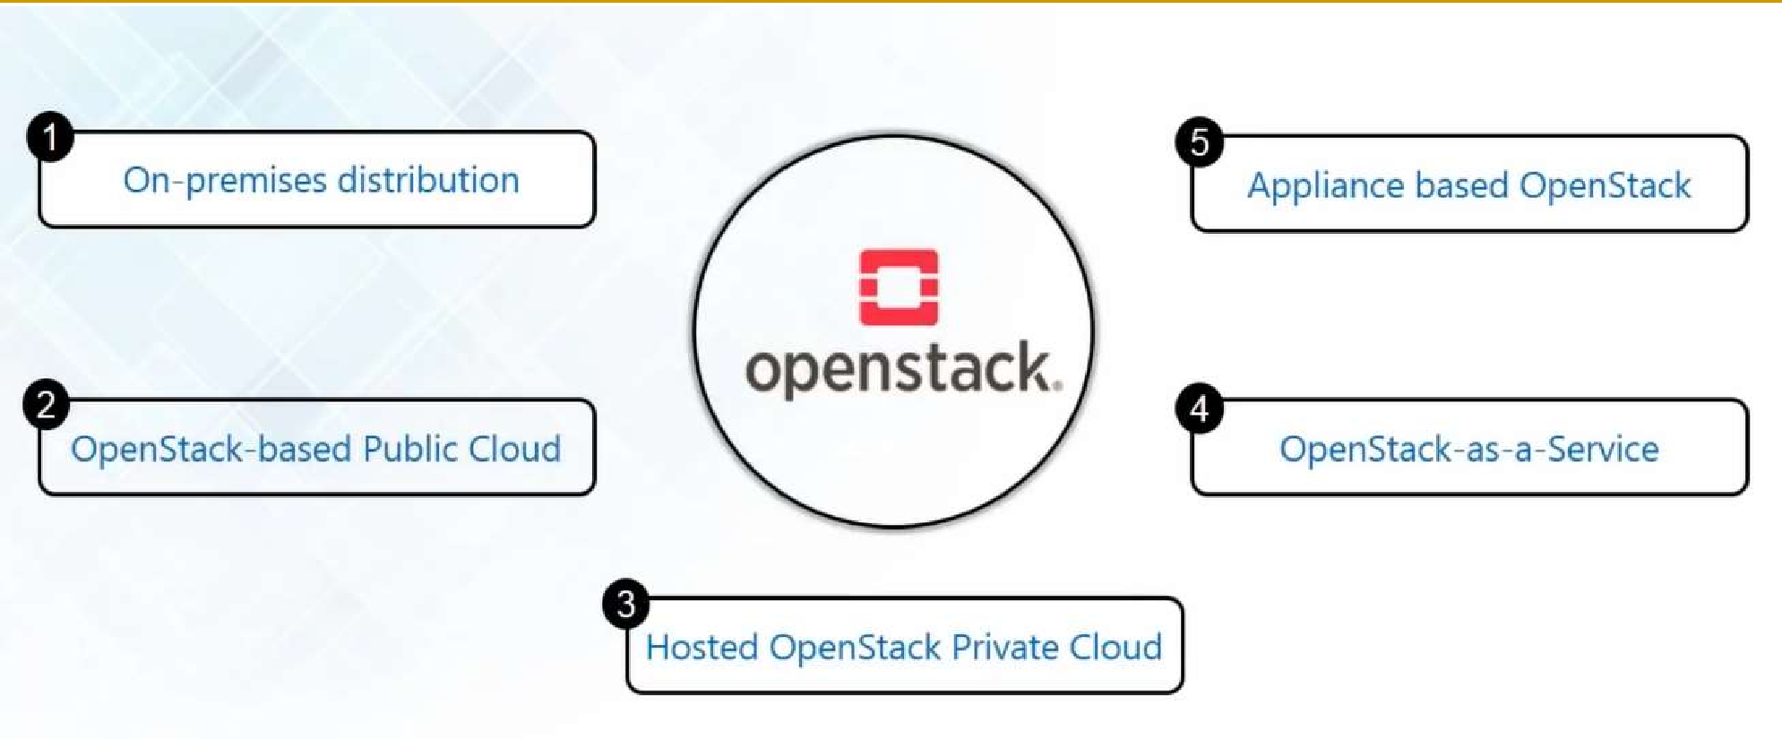
Deployment Models

Slide 9
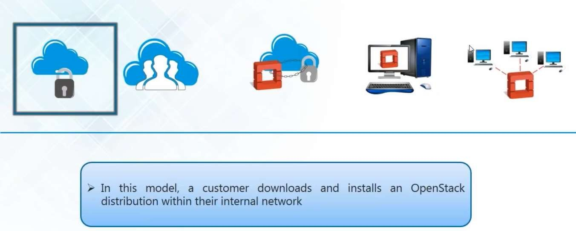
On-Premises Distribution

Slide 10
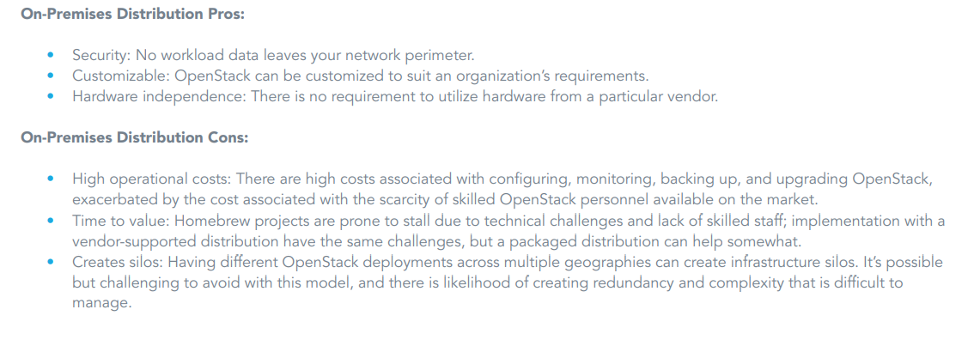

Slide 11


Slide 12
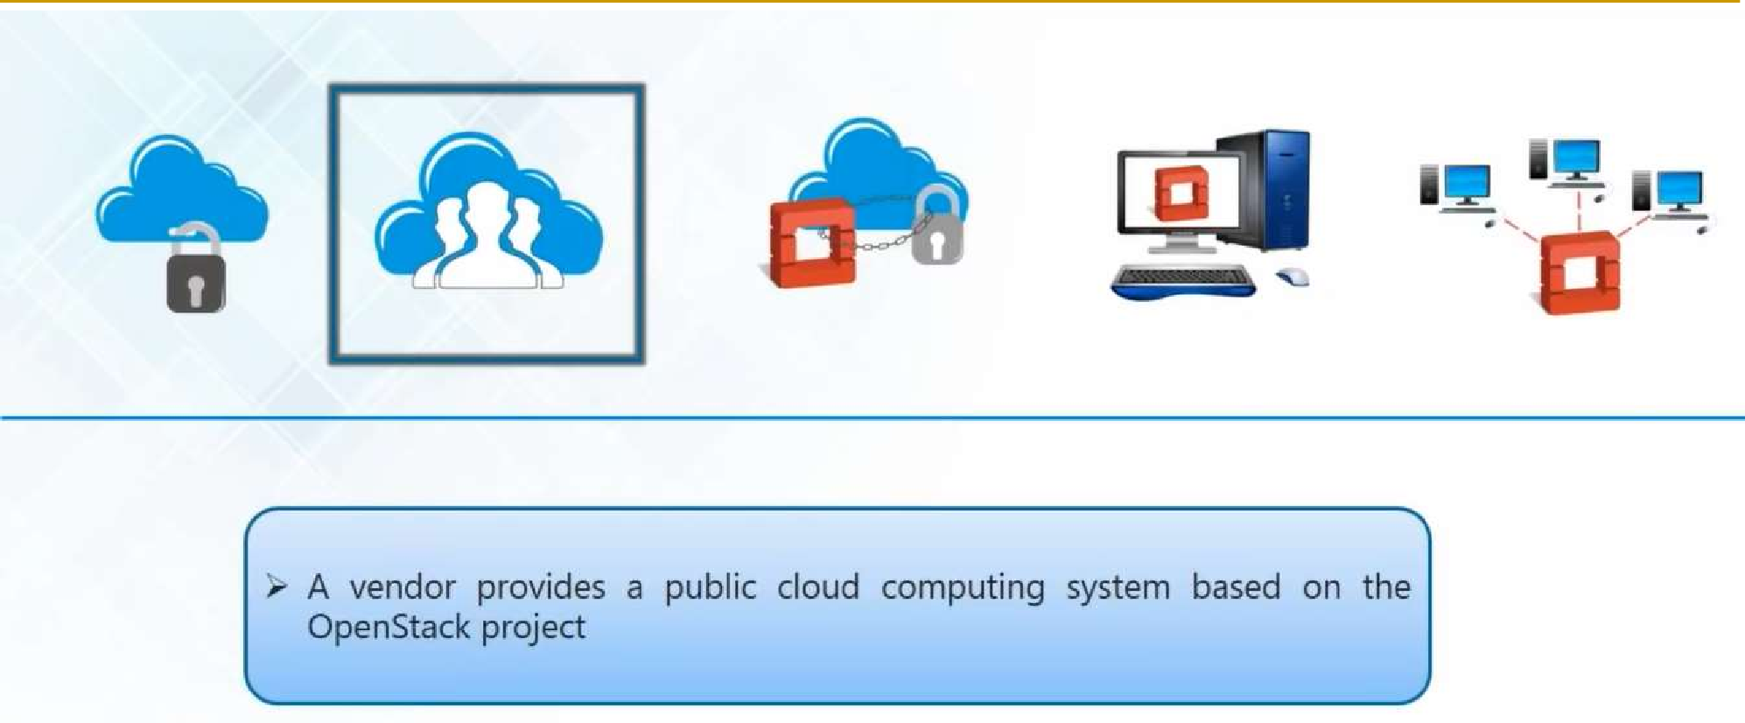
OpenStack-based Public Cloud

Slide 13
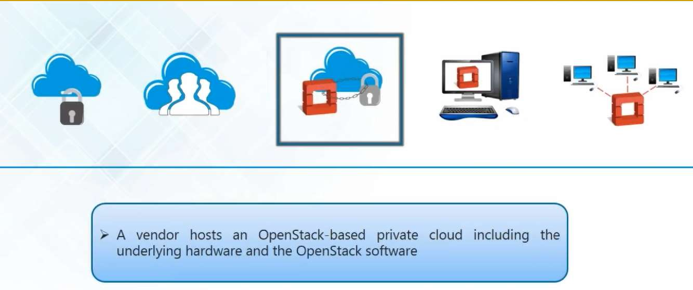
Hosted OpenStack Private Cloud

Slide 14
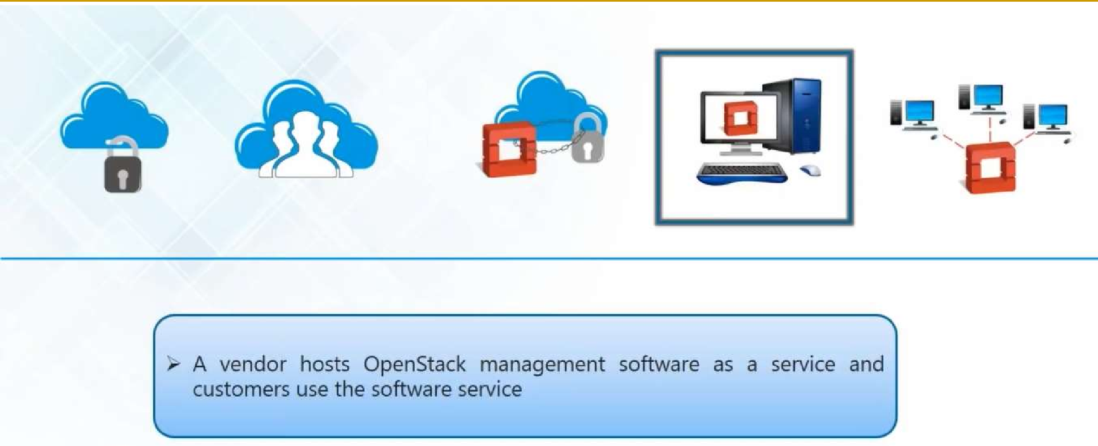
OpenStack as a Service

Slide 15
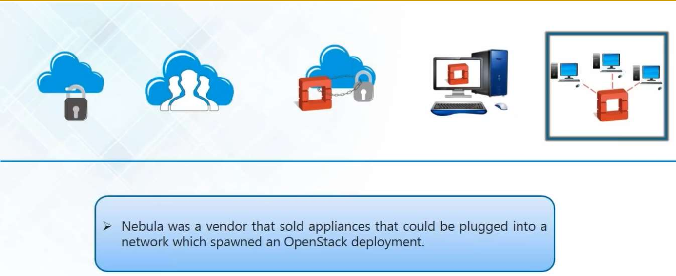
Appliance based OpenStack

Slide 16
OpenStack Architecture

Slide 17
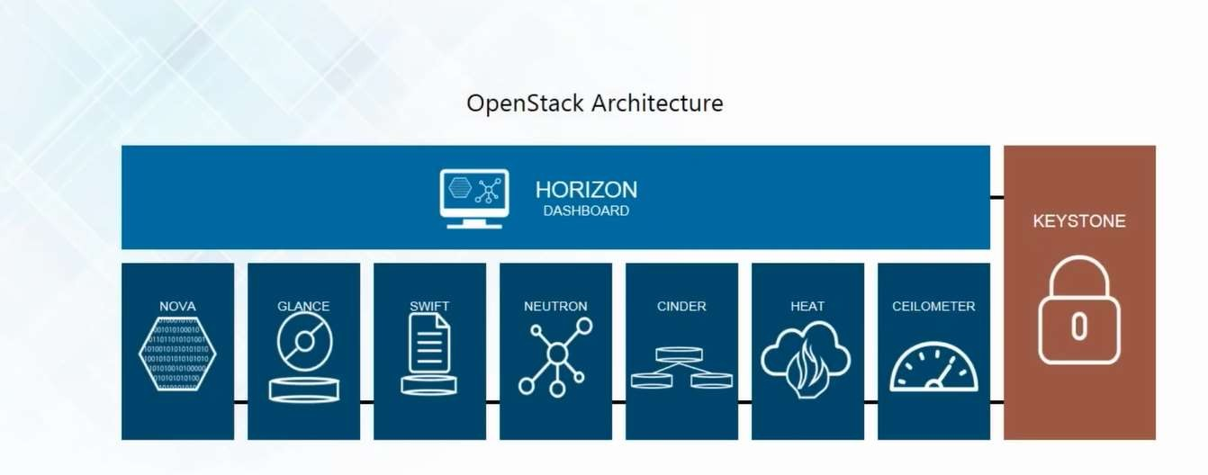
OpenStack Architecture

Slide 18
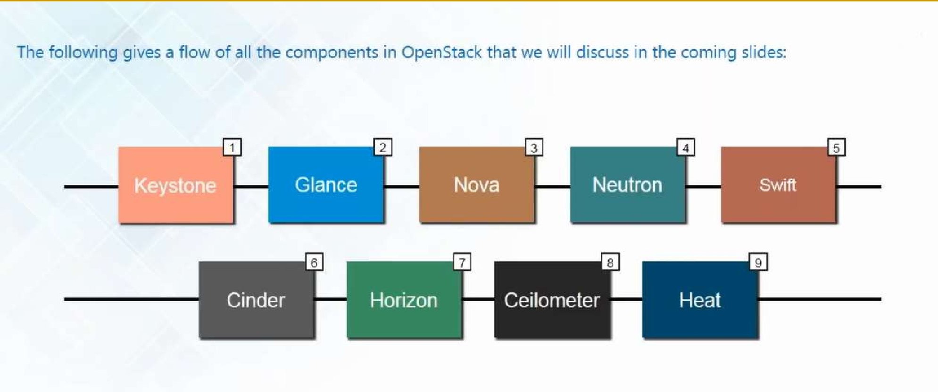
OpenStack Components/Projects

Slide 19
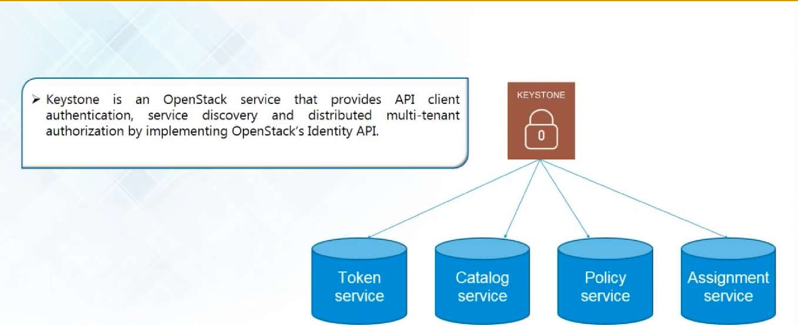
Keystone (Identity)

Slide 20
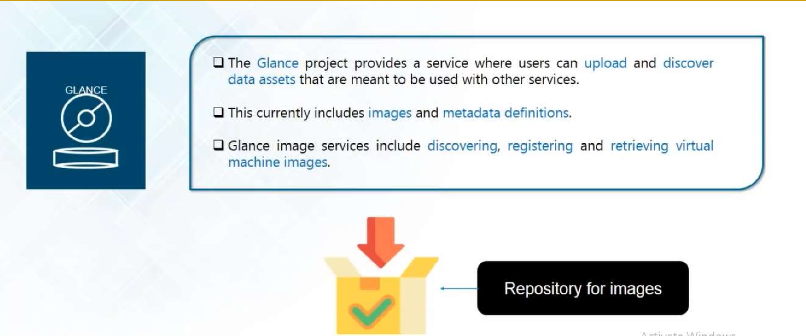
Glance (Image)

Slide 21
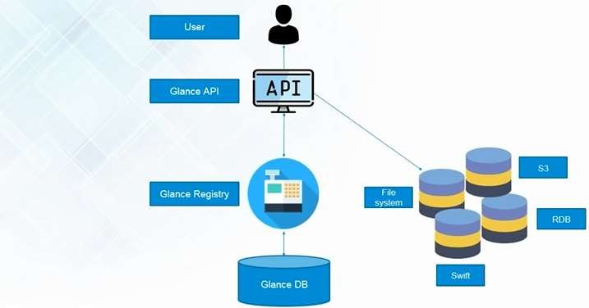
Glance (Image)

Slide 22
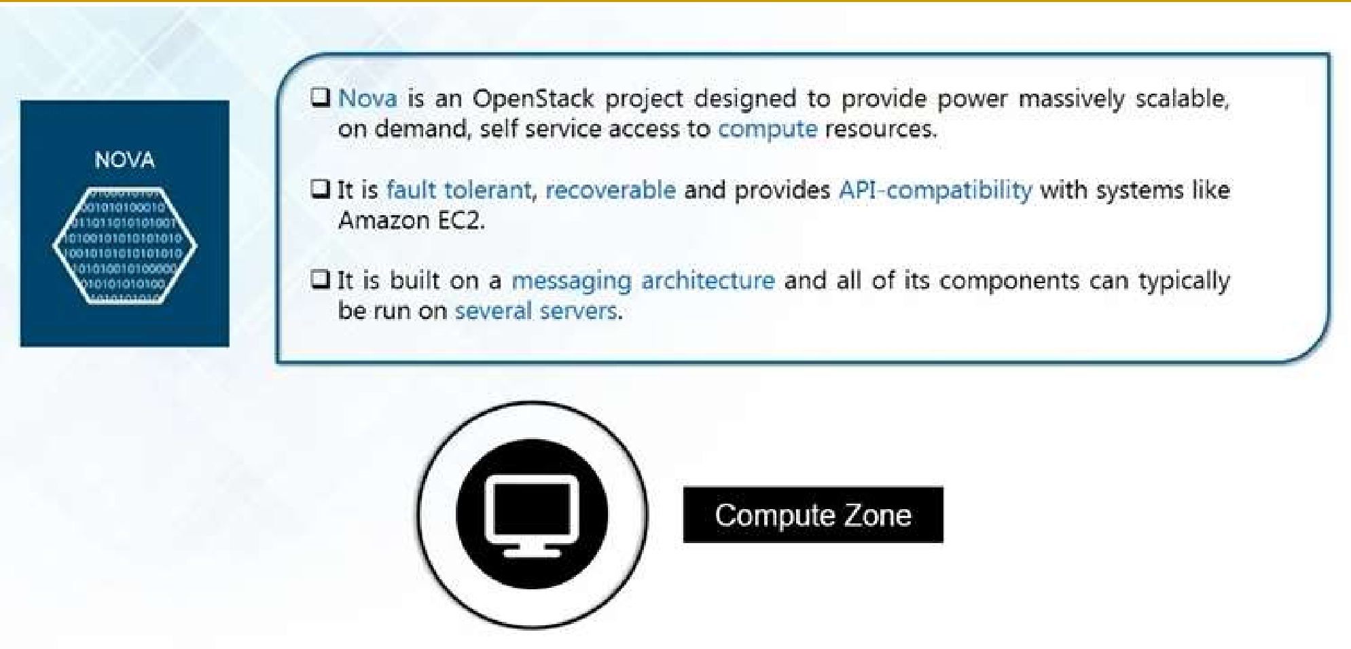
Nova (Compute)

Slide 23
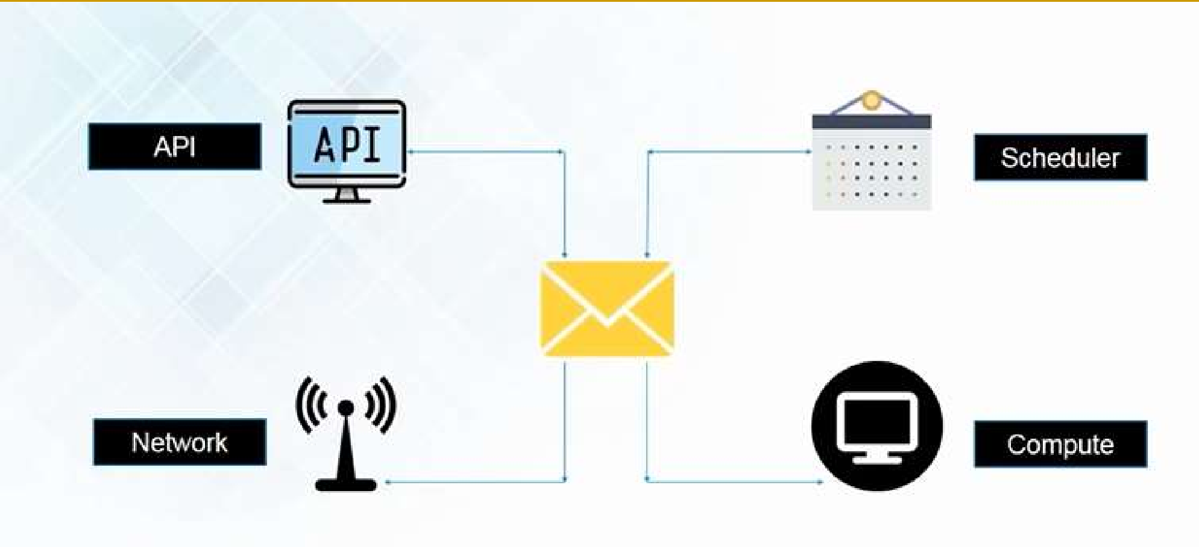
Nova (Compute)

Slide 24
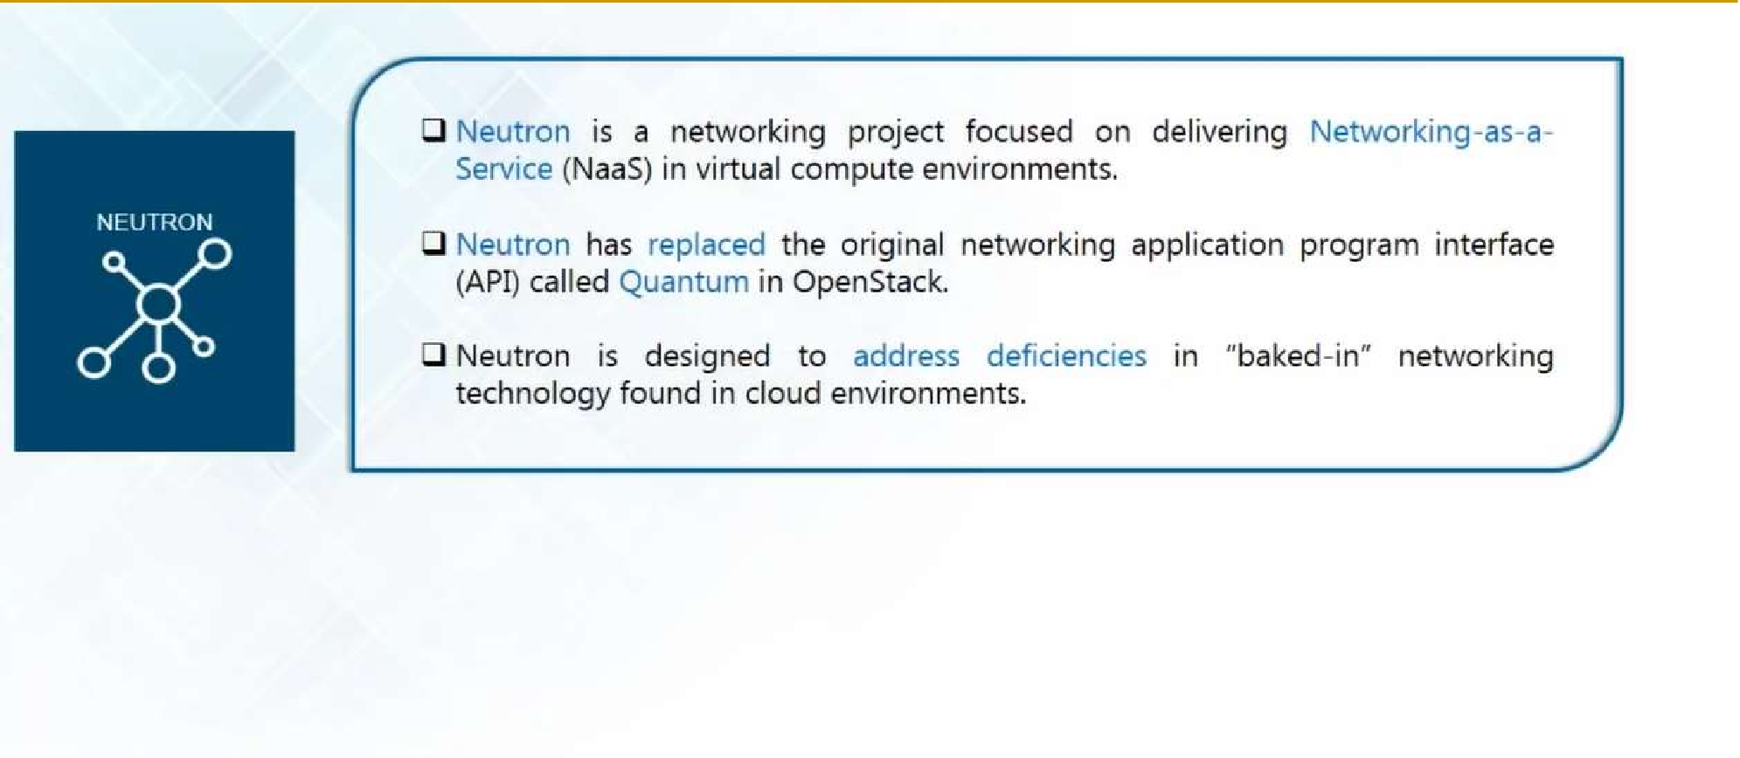
Neutron (Network)

Slide 25
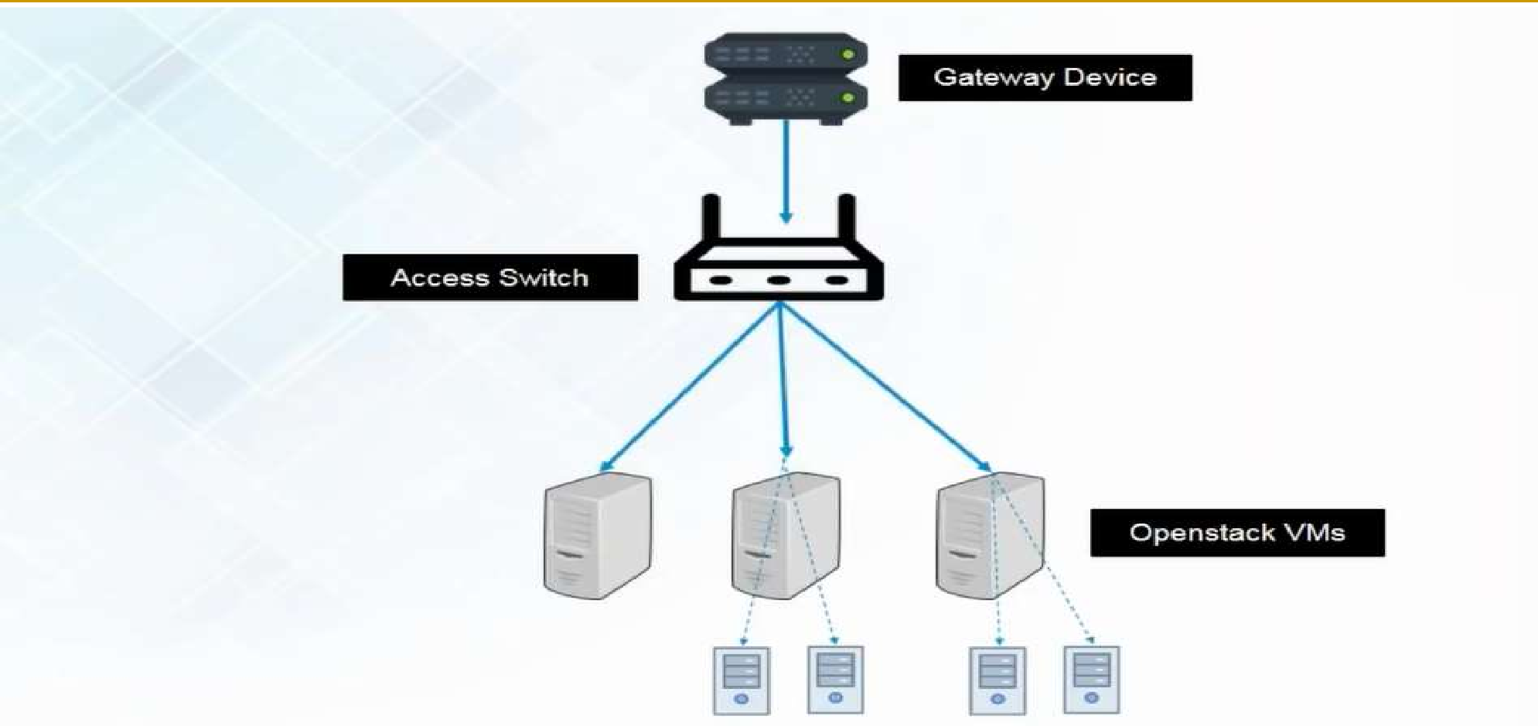
Neutron (Network)

Slide 26
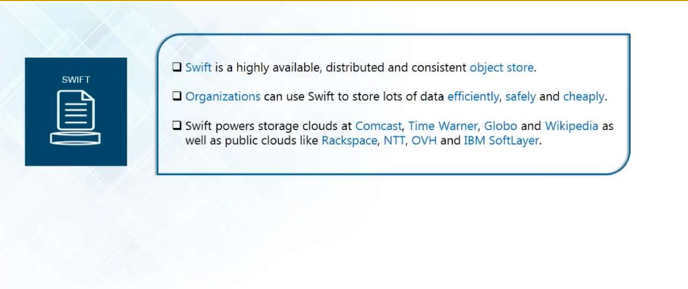
Swift (Object Storage)
20

Slide 27
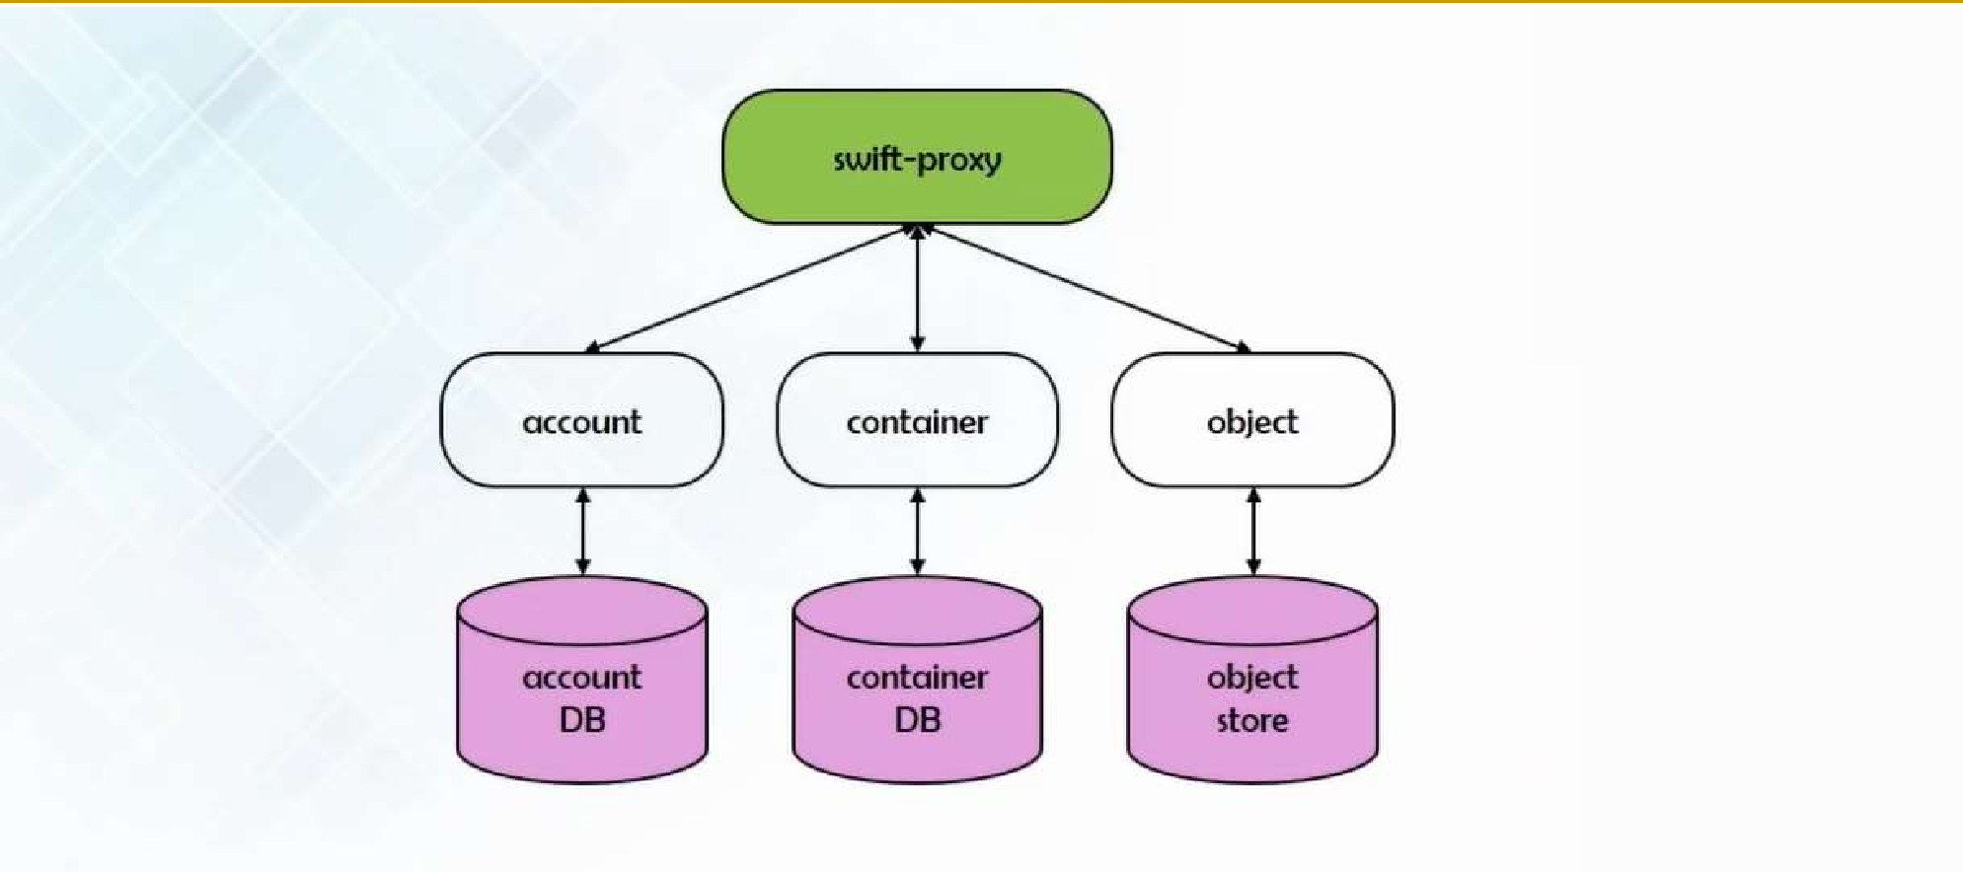
Swift (Object Storage)

Slide 28
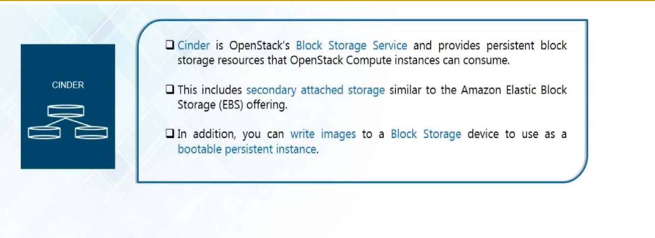
Cinder (Block Storage)

Slide 29
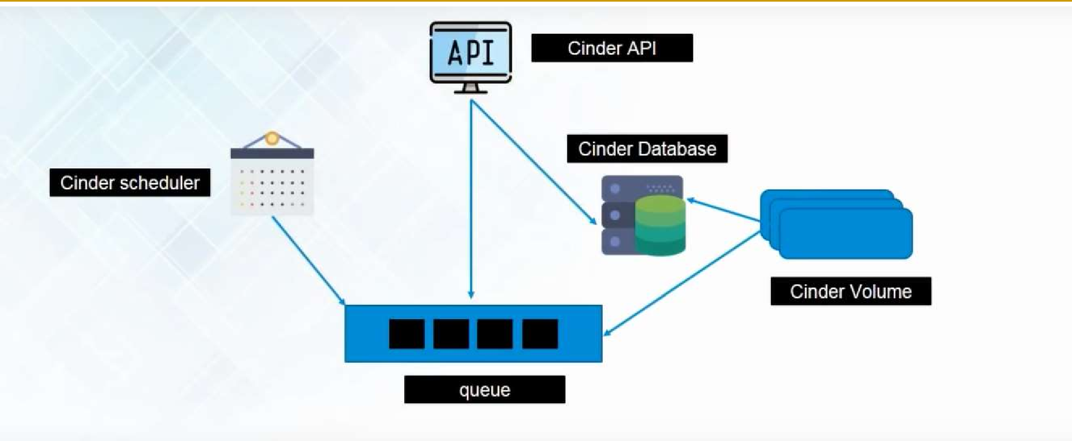
Cinder (Block Storage)

Slide 30
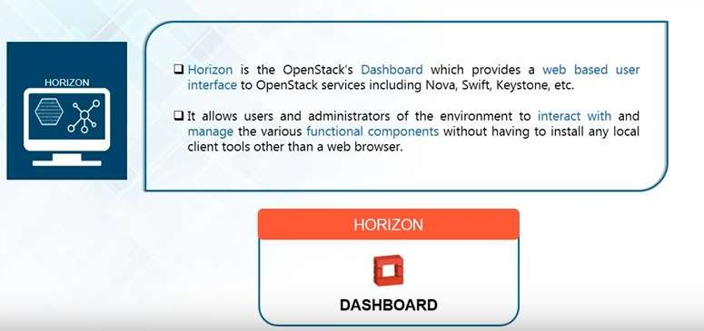
Horizon (Dashboard)

Slide 31
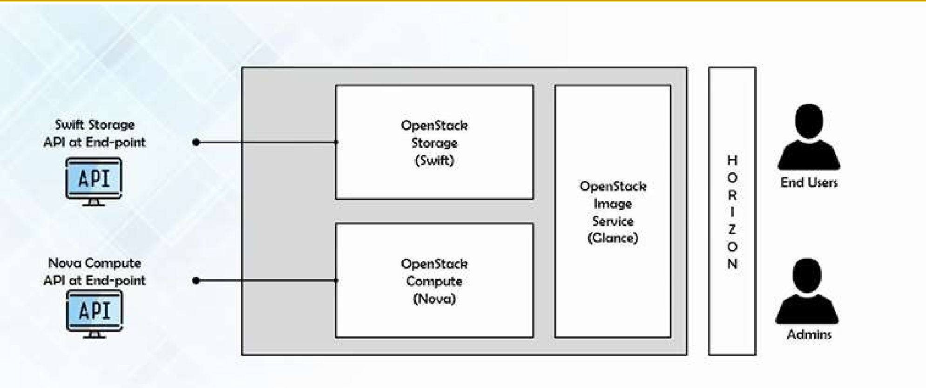
Horizon (Dashboard)

Slide 32
Thank you!
Any Questions???

